Slide 1
Distributed Computing
Module 1 -Lecture 5/6
Mahesh C.
Centre for High Performance Computing
FISAT

Slide 2
Logical vs. Physical Concurrency
Two events are logically concurrent if and only if they do not causally affect each other.
Physical concurrency has a connotation that the events occur at the same instant in physical time.
Two or more events may be logically concurrent even though they do not occur at the same instant in physical time.

Slide 3
Models of Communication Network
FIFO Model non-FIFO model
Causal ordering Model ( CO)
CO: For any two messages m_{ij} and m_{kj} , if send(m_{ij} ) → send(m_{kj} ), then rec(m_{ij} ) → rec(m_{kj} )

Slide 4
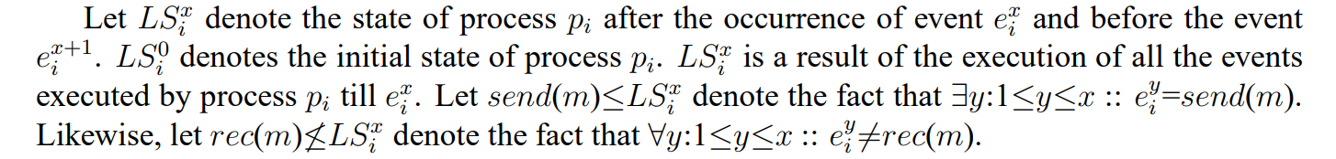
Global State of a Distributed System
The global state of a distributed system is a collection of the local states of the processes and the channels.
Process State

Slide 5
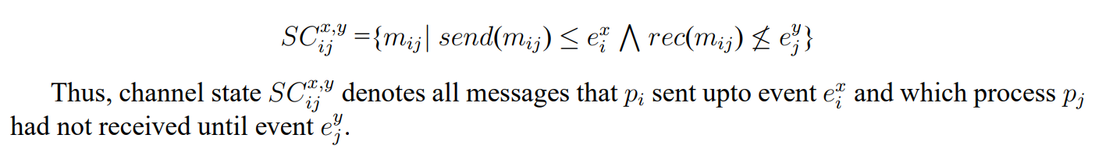
Global State of a Distributed System
The state of a channel is difficult to state formally because a channel is a distributed entity and its state depends upon the states of the processes it connects. Let SC_{ij}^{x,y} denote the state of a channel C_{ij} defined as follows:

Slide 6

Global State of a Distributed System
The global state of a distributed system is a collection of the local states of the processes and the channels. Notationally, global state GS is defined as

Slide 7
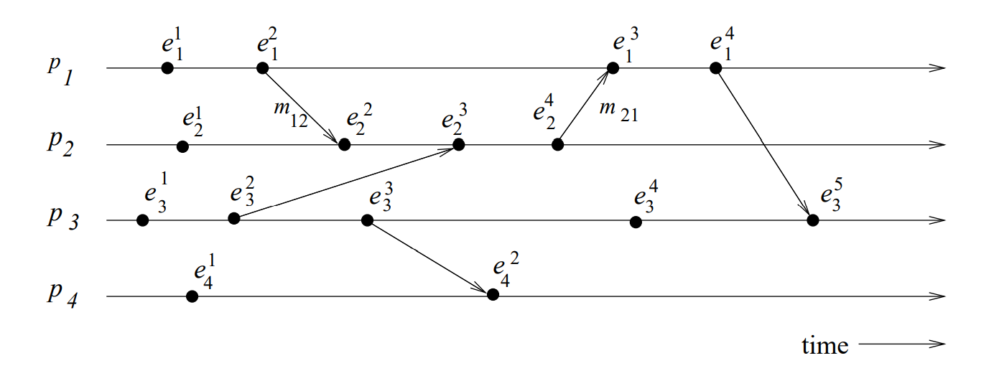
Global State - consistent
a state will be meaningful provided every message that is recorded as received is also recorded as sent.
space-time diagram

Slide 8


Global State - consistent or not

Slide 9

Global State - consistent or not

Slide 10
Cuts of a Distributed Computation
“In the space-time diagram of a distributed computation, a cut is a zigzag line joining one arbitrary point on each process line.”
A cut slices the space-time diagram, and thus the set of events in the distributed computation, into a PAST and a FUTURE.
The PAST contains all the events to the left of the cut and the FUTURE contains all the events to the right of the cut
For a cut C, let PAST(C) and FUTURE(C) denote the set of events in the PAST and FUTURE of C, respectively
Every cut corresponds to a global state and every global state can be graphically represented as a cut in the computation space-time diagram.
Cuts in a space-time diagram provide a powerful graphical aid in representing and reasoning about global states of a computation.

Slide 11
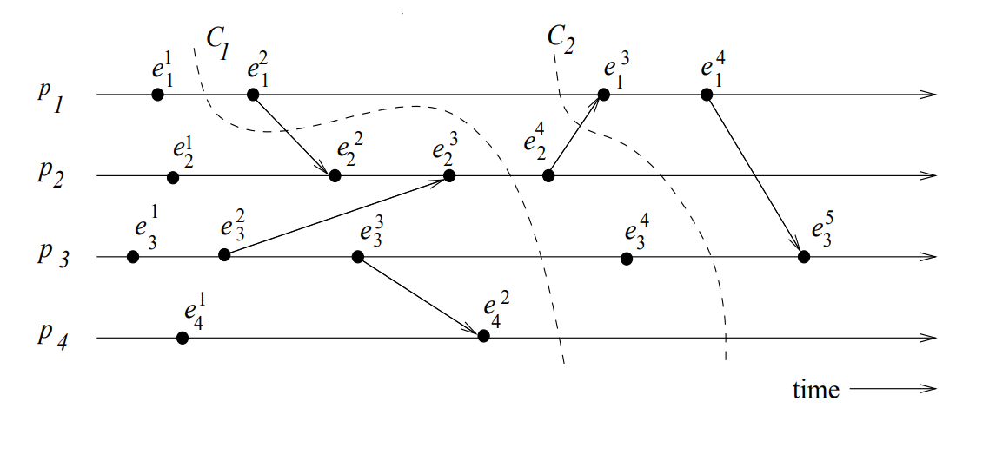
Cuts of a Distributed Computation

Slide 12
Cuts of a Distributed Computation
“In the space-time diagram of a distributed computation, a cut is a zigzag line joining one arbitrary point on each process line.”
In a consistent cut, every message received in the PAST of the cut was sent in the PAST of that cut. (In, cut C2 is a consistent cut.)
All messages that cross the cut from the PAST to the FUTURE are in transit in the corresponding consistent global state.
A cut is inconsistent if a message crosses the cut from the FUTURE to the PAST. (In Figure, cut C1 is an inconsistent cut.)

Slide 13

Past and Future Cones of an Event
“Past Cone of an Event”
An event e_{j} could have been affected only by all events ei such that e_{i} → e_{j} .
In this situation, all the information available at e_{i} could be made accessible at e_{j} .
All such events ei belong to the past of e_{j} . Let Past(e_{j}) denote all events in the past of e_{j} in a computation (H, →). Then

Slide 14
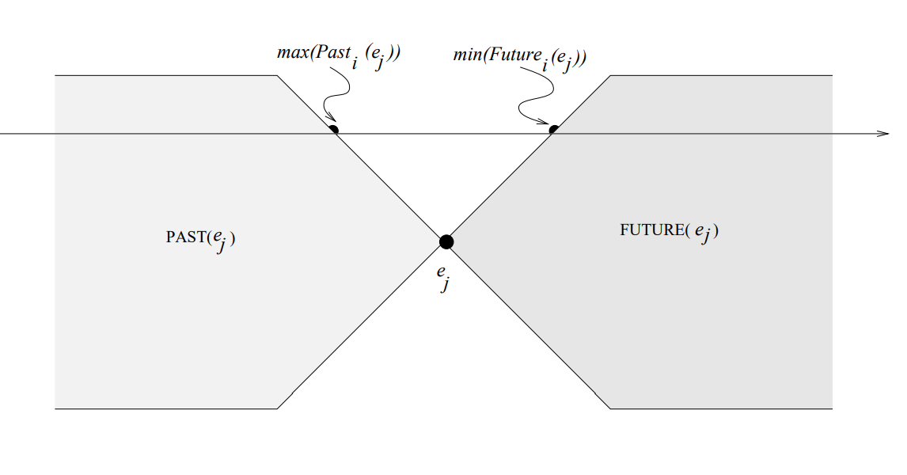
Past and Future Cones of an Event

Slide 15

Past and Future Cones of an Event
“Future Cone of an Event”
The future of an event e_{j} , denoted by Future(e_{j}), contains all events ei that are causally affected by e_{j}
In a computation (H, →), Future(e_{j}) is defined as:

Slide 16
Models of Process Communications
There are two basic models of process communications – synchronous and asynchronous.
The synchronous communication model is a blocking type where on a message send, the sender process blocks until the message has been received by the receiver process.
The sender process resumes execution only after it learns that the receiver process has accepted the message.
Thus, the sender and the receiver processes must synchronize to exchange a message.

Slide 17
Models of Process Communications
Asynchronous communication model is a non-blocking type where the sender and the receiver do not synchronize to exchange a message.
After having sent a message, the sender process does not wait for the message to be delivered to the receiver process.
The message is buffered by the system and is delivered to the receiver process when it is ready to accept the message.

Slide 18
Models of Process Communications
Asynchronous communication provides higher parallelism because the sender process can execute while the message is in transit to the receiver.
However, A buffer overflow may occur if a process sends a large number of messages in a burst to another process.
An implementation of asynchronous communication requires more complex buffer management. In addition, due to higher degree of parallelism and non-determinism, it is much more difficult to design, verify, and implement distributed algorithms for asynchronous communications.
Synchronous communication is simpler to handle and implement. However, due to frequent blocking, it is likely to have poor performance and is likely to be more prone to deadlocks.

